Slide 2
5G and Beyond: Resetting expectations in the face of disappointing growth
Dr. Ronan de Renesse
Senior Research Director, Service Provider
Notes:
We need to set out what the objectives are of the presentation.

Slide 3
4G vs 5G: it’s not as obvious as we thought
Perception
Reality
Outlook
3G and 4G took much longer to take off
Source: World Information Service – Service Provider (WIS-SP), WCIS Data Dashboard

Slide 4
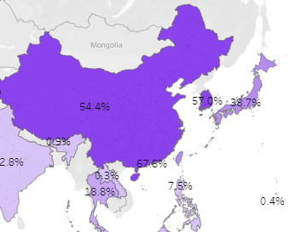
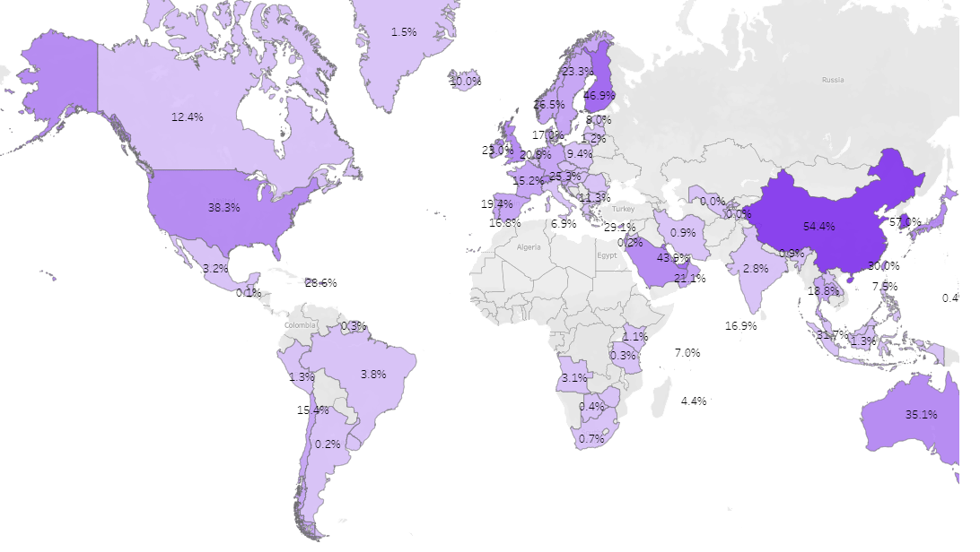
5G is only 10% of connections but >50% population penetration in leading markets like South Korea
5G population penetration 1Q2023
Source: World Information Service – Service Provider (WIS-SP), WCIS Mobile Market Visualisations

Slide 5
5G market leaders show growth drops after 20% penetration
Market growth
Market maturity (penetration)
Source: World Information Service – Service Provider (WIS-SP), WCIS data dashboard

Slide 6
5G smartphone activation rate is decreasing
5G activation rate decreased 10pp to 44.9% in 2022. What does a decreasing activation rate means:
More 5G smartphones have been sold in areas where 5G was not available (e.g. India)
People upgrade to 5G smartphones without upgrading to a 5G tariff
Some people may have a 5G smartphone but their network operator does not offer 5G services
Source: World Information Service – Service Provider (WIS-SP), WCIS data dashboard
Notes:
32.3% of smartphones in circulation were 5G capable in Q4 2022 (up from 16.1% a year ago) but only 14.5% actually use the network (up from 8.8% a year ago). 5G activation rate decreased to 44.9% this year from 54.6% a year ago.

Slide 7
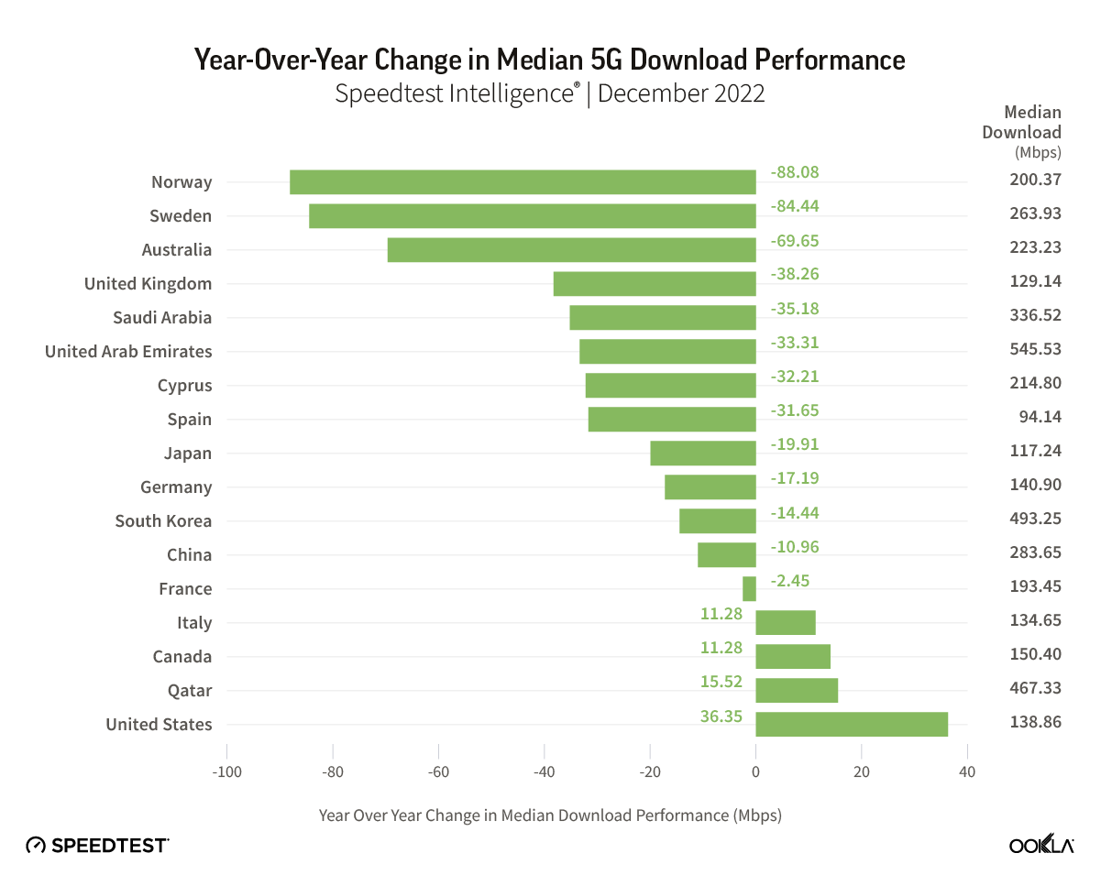
Network performance gain is difficult to show
The quality of the networks vary greatly by market
Network density needs to grow as adoption grows
Financial pressure from rising costs and declining ARPUs has slowed-down 5G network deployments in Europe in particular
The US C-band spectrum has helped operators like T-Mobile adding capacity to the network and offer higher quality of service
Vodafone UK recently advertised a new 5G Ultra network based on 5G standalone

Slide 8
There is no correlation between 5G and ARPU
Source: World Information Service – Service Provider (WIS-SP), WCIS data dashboard

Slide 9
But service revenues are growing alongside 5G penetration
5G SIM penetration
Revenue YoY growth

Slide 10
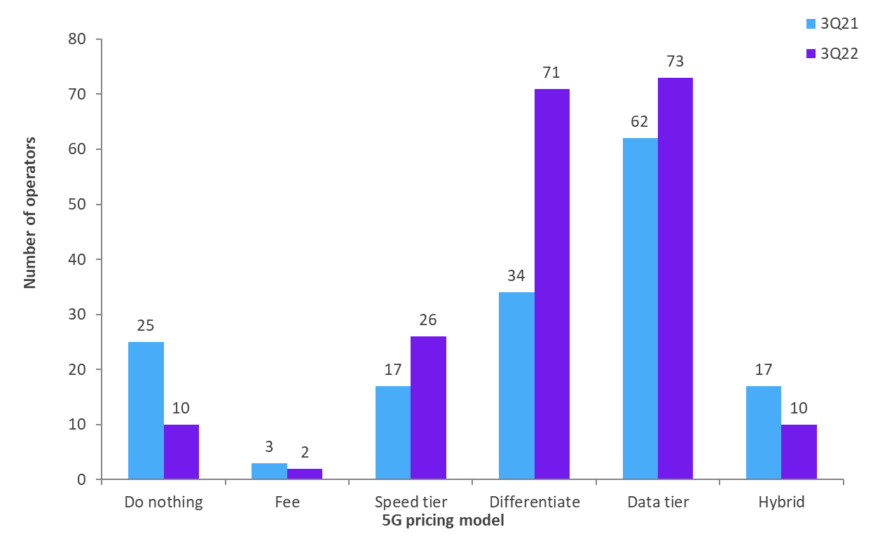
Consumer: 5G-rich apps bundles can help shift ARPU but they come with a cost
Omdia’s six 5G pricing models – 3Q21 vs 3Q22
Bundling 5G-rich apps into 5G plans is the most effective strategy for selling 5G in the consumer market
5 of the 10 most penetrated 5G markets around the world include operators that bundle 5G-rich apps
Operators in Korea and Taiwan are keen app bundlers, with Korean telcos each offering multiple 5G-rich apps – saving premium apps for the most expensive 5G plans.
5G penetration in some GCC markets is quite high, but operators typically don’t use the Differentiate pricing strategy.

Slide 11
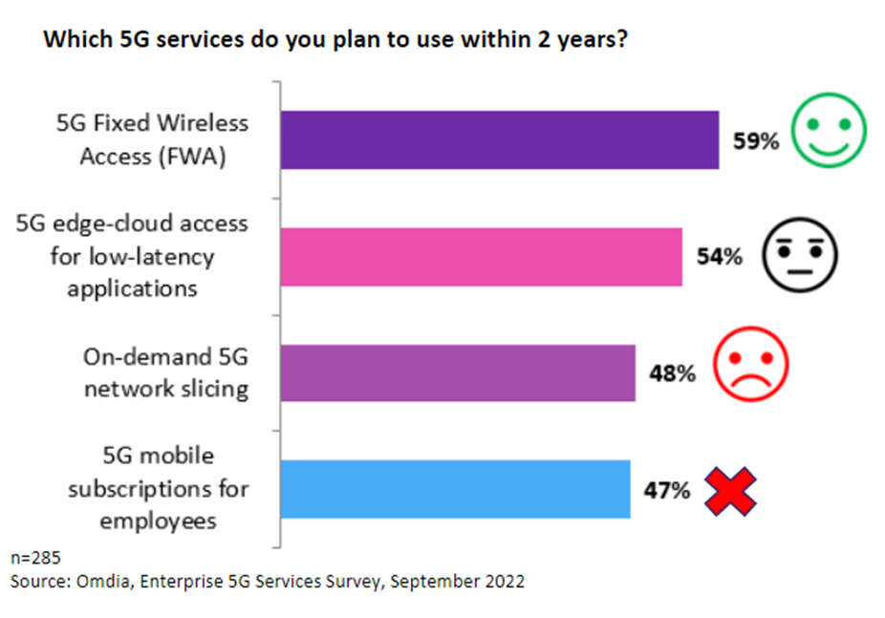
Enterprise: Private networks offer some opportunities but FWA and MEC are more scalable

Slide 12
5G connections will reach 5.9 billion in 2027 but 4G to remain dominant until 2026 driven by IoT
✓ 90%+ network population coverage
✓ Wide spectrum availability
✓ >50% of devices 5G enabled
✓ Unlimited data and no price premium
✓ Multimedia bundles
✓ Attractive FWA SME bundles
✗ <50% network population coverage and staggering network deployment
✗ Delayed spectrum auctions
✗ Direct price premium comparisons with 4G >10%
✗ Poor service marketing and lack of use cases
46.7%
45.7%
Source: World Information Service – Service Provider (WIS-SP), WCIS data dashboard

Slide 13
FWA connections will double in the next five years
Source: World Information Service – Service Provider (WIS-SP), WBIS data dashboard

Slide 14
The telco business model needs to change
In the next 5 years:
Traffic will grow 218.9%
Revenue will grow 14.6%
ARPU will decline by -7.5%
46% of telco CEOs think their companies won’t make it passed another decade according to a survey form PwC.
There needs to be a clearer link between traffic (or network use) and revenues. Open APIs like the Open Gateway initiative can help monetise particular network uses.
Service providers need to run their networks more efficiently by shutting down legacy technology and moving network operations to the cloud (public or private)

Slide 15
The 5G roadmap for the next 5 years will take a decade
 | Release date | Commercialisation | Primary focus | Secondary focus
Release 15 | Throughout 2018 | Q4 2019 | 5G eMBB sub-6GHz and mmWave. | 5G SA, 5G core, network slicing
Release 16 | Q2 2020 | Q2 2022 | URLLC (Ultra-reliable low latency communications), Industrial IoT. | Enhanced location services, private networks, V2X, unlicensed bands
Release 17 | Q3 2022 | Q2 2024 | Industrial verticals, mmWave 52.6-71Ghz, non-terrestrial networks (e.g. Satellite, HAPS) | Public safety, private “5G as-a-service”, multi-cast/broadcast, cloud gaming QoS, optimised edge, NR-Light and RedCap devices
Release 18 (5G Advanced) | Q2 2024 | Q2 2026 | AI and ML, lower network energy consumption, XR | Security and privacy, network automation, duplex operation, multimedia codecs
Commercialisation/deployment of a 3GPP release takes at least 2 years (chipset manufacturer, equipment manufacturing, network deployment etc.) Products based on Release 16 come out in 2022 (now)

Slide 16
Conclusions
5G is missing expectations
45% of 5G smartphones are not 5G active
5G networks need to be better
Scalable B2C and B2B opportunities are about transition to 5G rather than upselling something new
The telco business model needs to change

Slide 17

Your Presenter
Dr. Ronan de Renesse
Senior Research Director, SP Market
Omdia
ronan.derenesse@omdia.com

Slide 18
Shifting Business Models: Do new ways of working with hyperscalers offer hope for telcos?
Evan Kirchheimer
Research Vice President, Service Provider
Notes:
We need to set out what the objectives are of the presentation.

Slide 19
Traffic is growing, but are revenues?

Slide 20
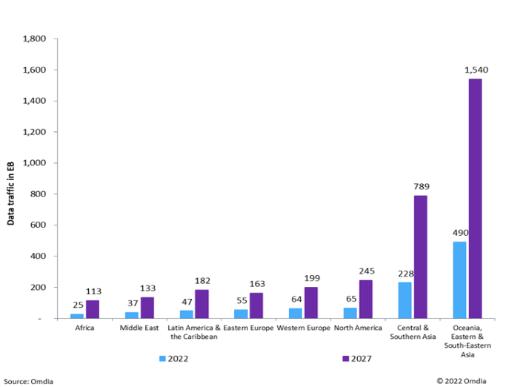
We know this story: a massive rise in traffic, powered by video
Global data traffic, petabytes/year, 2002 - 2027
Regional cellular data traffic, 2022 - 2027
1
Cellular and fixed traffic will reach 5.8 million petabytes by 2024
2
The average subscription will consume over 22GB/month of data by 2027, up from 8GB in 2022.
3
Video will account for 80% share of traffic volume in 2024

Slide 21
Sustained demand will continue to power connectivity growth
Demand driver
1. Global cellular connection 2019-27
2. Global fixed connections 2019-27
1. Mobile connections +21%
2.2 billion cellular connections added between 2021-26.
Source: Omdia
Source: Omdia
2. Fixed connections +18%
243 million connections added between 2021-2
3. Global installed base of connected consumer devices by type, 2019-27
3. Things +115%
8.9 billion devices added to our homes 2019-25
Source: Omdia
Demand fundamentals are sound – the need to be connected is accelerating

Slide 22
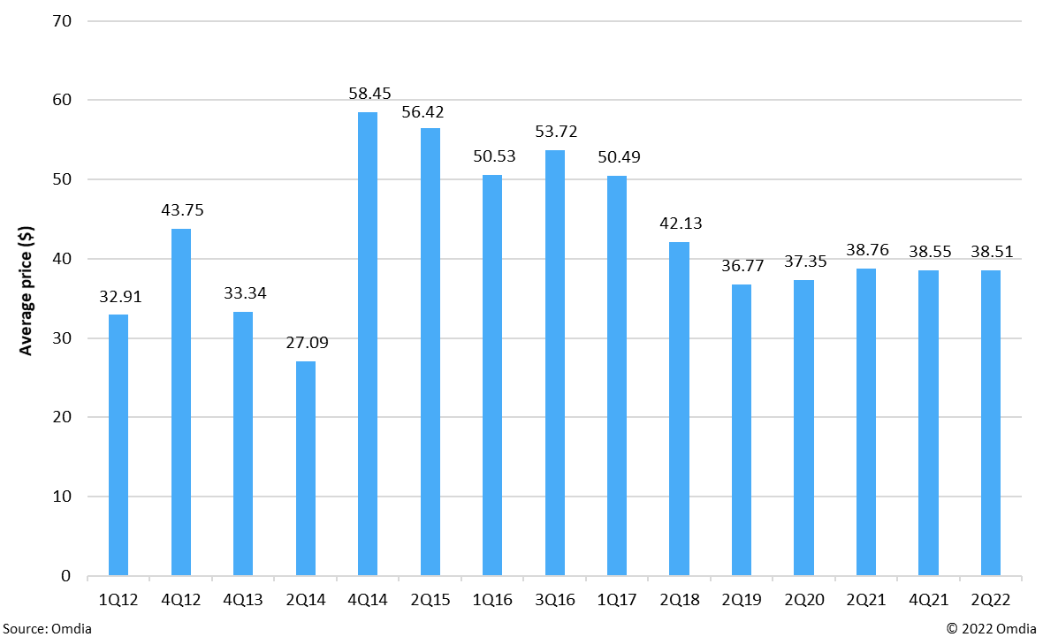
Providers offer more for less, or at best: more for the same
1
Mobile tariffs have held steady since a decline in the late 2010s. While in some markets these are increasing by inflation, in others they continue to fall in real terms.
2
By 2027, global revenue per GB of cellular data will be $0.25, a reduction of 66% from 2022. For FBB, global revenue per GB will be $0.07 in 2024, down from $0.19 in 2019.
Post-paid plan pricing is eroding in real terms
Bandwidth revenues fall
Average 30-day plan price over time ($), mobile BB, global
Source: Omdia
The industry doesn’t only need more connections and consumption: We need more product.

Slide 23
The OpEx Challenge

Slide 24




Germany: Europe’s largest economy in the last decade
In 2016, the German economy (GDP) was worth about USD $3.5 trillion*.
* Source: World Bank, Current USD
Over the last decade, telcos have spent $3.6 trillion on capital.
* Source: Omdia CapEx and Revenue Tracker

Slide 25
Telecoms CapEx of $3.6 trillion since 2012 – where has it led?
Over the entirety of the decade, there was a 1% increase OpEx/revenue ratios.
Positive Outliers include Bharti, Charter, KPN, Tele2, Telenor, Charter and Turkcell achieving OpEx/revenue ratio reductions of over 10%. Others have achieved OpEx/rev reductions of c5%: Softbank DT, BT, Verizon, KDDI, Vodacom.
Many of the above have increased CapEx intensity for declines in OpEx/rev ratios.
OpEx/revenues has increased the most at Singtel, China Telecom and China Mobile. In some high-growth markets, a very significant increase in CapEx in absolute terms may be masked by the top line. Such is the case with China Unicom.
Spending to save
Both CapEx and OpEx outgrowing revenues
Saving while constraining
Controlling CapEx in line with revenues, but growing ops cost
As an industry and as a whole, telcos have made absolutely no change to their OpEx and CapEx fundamentals in aggregate
Notes:
Only 9 of the 28 major operators reduced their OpEx over the period, and of those only 3, or 11% of those under consideration, did so in an ‘efficient’ manner.

Slide 26
OpEx spend as a % of revenues: traditional v cloud approach
Traditional
Cloud-led
Network ops %
Network ops % (19.5% traditional)
Sunsetting of legacy networks will partially mitigate network operations OpEx increases, but moving network functions into the cloud will accelerate this, allowing for a projected 50-75% reduction in headcount.
Legacy networks
Expanding network coverage Rising power
RAN densification
Key cloud functions
50-75% headcount
reduction
IT operations
IT operations (7% traditional)
Enterprises show a 4% IT ops spend decrease (as % of revenues) via public cloud, Telcos will drop 3.7% (from 6.2% to 3.5%). There will be a dramatic increase in VMs managed per head. Staff will shift to a focus on dev. Shorter production release intervals.
Session mgt Automation Slow cloud migration of legacy
OSS/BSS
50% saving in IT ops
Massive increase in VMs managed/head
Content
Content (3.6% traditional)
Digital bundling Gaming Ad funded content deals
Telcos drive better
content deals with AWS/Google
Telcos will drive better content deals with hyperscalers as they deepen relationships.
Other OPEX levers (outside sales ops) are not falling
Notes:
Network ops is rising as a result of increasing network complexity, rising power costs. We are expecting slowing OPEX growth here through Softbank automation and some telcos are bringing forward 3G and PSTN networks.
IT ops is growing, as more software-centric models are implemented – greater application of data analytics, security and deployment of digital services. To deliver more granular session control, through technologies such as network slicing all drives
Massive growth since 2009, most operators now take on new content costs as they continue to bid aggressively for content.
Other cost drivers do not move all that much. Inteconnection costs and leased networks have fallen sharply since 2009, but we don’t expect to see significant shifts in spend here.
If then, we look to virtualise as much infrastructure and simplify the management of that infrastructure as much as we can – the hyperscalers offers a rather different cost proposition to the industry.
We discussed the OPEX impact that the hyperscalers think that they can have on traditional OPEX spend and then averaged those out across the key categories.
The average Network Ops falls from 19.5% of opex, down to 13.5 – cheaper than it was in 2009. Efficiencies here are through headcount reduction, as network management is simplified on their plaforms.
IT operations halves, through efficiencies achieved through massive increase in VMs managed per head (virtual machines?). [is there anything more here to explain the drop?]. Common platforms developed once can be re-used?
Rising network densification and greater application of IT across this complexity if eroding OP.

Slide 27



Three emerging models: telcos will be lean, light and local
Lean
Light
Local
Ever-leaner insourced operations
Asset-light, cloud-focused, open
Outsourced network functions, access
Focus on the data plane
Wholesaling services to other telcos and internet providers
Limited retail/enterprise
Disposal of non-profitable assets
Lease-back of some infrastructure
Focus on control plane
Operational transformation through cloud
New product: analytics, edge, security, managed services
Network as enabler: Open vRAN, slicing, marketplaces
Outsourced core network functions and third-party services (hyperscalers)
Local retail functions
Access
Service delivery directly or via partner ecosystem

Slide 28
Hyperscalers and Telcos: will a closer embrace create new business models?

Slide 29





The Five Telco-Cloud Business Models
Buy-from
A cloud provider sells cloud services to the CSP, with the aim of moving workloads from premises-based and CSP-owned to the public cloud.
Cloud providers offer CSP connectivity services on their marketplaces. CSPs set up their own B2B cloud marketplace or draw on hyperscaler economies of scale as part of their B2B managed services propositions.
Marketplace
Sell through
A CSP resells a cloud provider’s services, often with a focus on unified communications or office productivity suites.
Cloud providers and CSPs align and launch services jointly for enterprises that want their compute and connectivity suppliers to bundle relevant offers such as VPN and cloud.
Side-by-side
Deep collaboration between CSPs and hyperscalers to co-develop and launch new unified services, the components of which would not be complete or able to stand alone without the others
Co-investment

Slide 30



Five new telco cloud business models
1. Buy-from
2. Marketplace
3. Sell through
4. Side x side
5. Co-investment
Cloud
Network
Provisioned & billed
Provisioned & managed
User
OPEX control
Revenue growth
Revenue growth
Revenue growth
OPEX control/Revenue growth
Cloudify operations and BSS
Pair network and apps
Resell with service management
B2B: complementary skills and services
B2B: co-create new service or business model
Use case

Slide 31

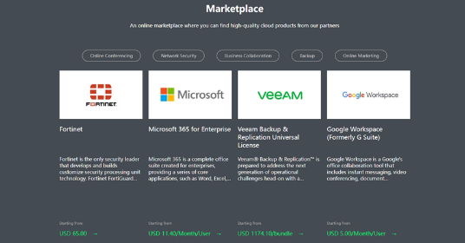


‘Buy from’ and ‘Marketplace’: deep dives –AWS, China Mobile, Rakuten
Buy from: Cloudify operations and BSS
More efficient deployment of 5G core
Increase in staff focused on new functional devs
Staff productivity – account creation, VMs
Agility – CNFs launched in weeks
Sym –plan; build; ops; manage; oRAN; cloud
Marketplace: China Mobile mCloud and Rakuten (Symworld)
Rakuten eCommerce marketplace

Slide 32



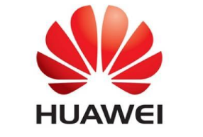

‘Sell through’ and ‘Side by side’: Telefónica Tech, Unicom, Huawei
Sell through: Telefónica Tech and BE-terna for MS Dynamics
Acquisition in attempt to move up B2B value chain
Full-service consult, integration, management
ERP – focus on manufacturing
Future: Increasing emphasis on cross-selling connectivity
Side by side: China Unicom and Huawei: One Telco Cloud for 5G PNI-NPN (Public network integrated non-public network
One Telco Cloud for 5G - service
Automation, integration with PSTN
Rapid stand-up in 8 regions across industries
Hundreds of customers – Midea, Ferrotec, etc.

Slide 33

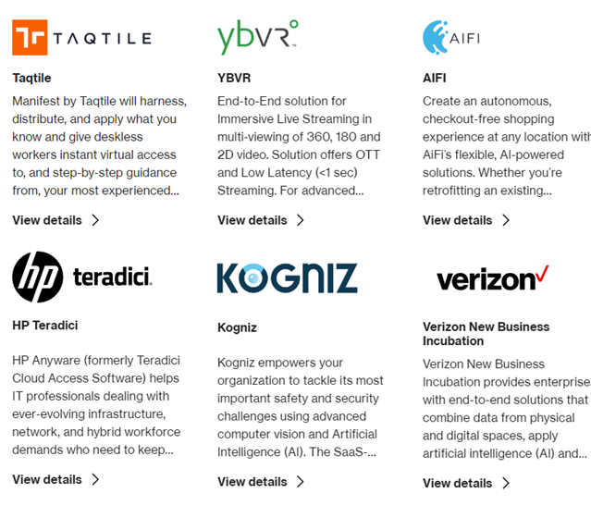


Co-investment: Verizon’s multi-pronged approach to 5G Edge
In this collaboration, which is focused on warehouses and other distribution centers, the two providers integrated Verizon’s private network platform with Azure Stack Edge, enabling low-latency data access, processing and analytics.
The aim of the service is to enable AI vision to guide stock picking and product packing.
Verizon’s 5G Edge Partners
Verizon’s partnership with Google is newer, but it announced plans late last year to work with Google to launch services based on Google’s Distributed Cloud Edge. A cross-industry initiative, the initial focus is on the smart factory, with Ericsson joining in to co-develop a proof of concept for its own 5G Smart Factory located in the Dallas metro area. In combination with Verizon’s Sensor Intelligence service, a video-enabled autonomous robot will scan packages and maintain inventory in the factory’s warehouse.
Verizon and AWS offer both private (AWS Outposts) and public (AWS Wavelength) edge compute and network options. While cross-industry, there is a particular focus on the vehicle-to-everything (V2X) opportunity. V2X includes vehicle to vehicle communication, but also communications with other infrastructure such as poles, smart lanes, traffic lights and even pedestrians with cellular devices. Verizon has announced that LG Electronics is developing its V2X services, which it will sell onward into the auto sector. Another automotive industry player co-developing with Verizon and AWS is Nissan.

Slide 34
Conclusions

Slide 35
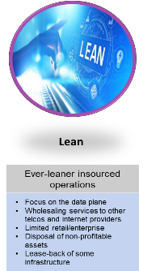
Conclusion 1: The current course is a lean, utility industry.
Before….
2023 and beyond….
The next G will deliver growth
5G isn’t. 6G definitely won’t. What models and partnerships are you exploring to grow?
Consumers will pay more for more
Only small gains have been realised. How will you profit from compelling B2C and B2B digital services?
I can grow as a B2B provider
Telco B2B is flat. Are you taking an ecosystem approach? Are managed services in your sights?
Regulators will save my business model
They might. Will hyperscalers eat your network next?
Costly and complex muti-generational networks
Simplified lower cost networking

Slide 36
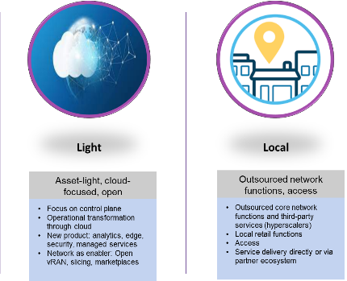
But another conclusion is possible: New paths to cheaper networks with new network functions and services
Opportunities to drive new revenues
Be the best you can here (with or without hyperscalers)
50 x bandwidth intensity
50 x bandwidth
50/100G PON (G/XGS PON)
Wi-Fi 7/ 5G Release 18/6G
Massive IOT
Mixed reality, highly responsive
More, smaller screens in the home.
Mixed reality
Low latency networks (-1ms)
But will customers pay more for high performing networks?
Telcos may be here with hyperscalers
Telcos will definitely be here
Multi-domain networked AI
Personalise services
Sensing status, location and consumption of endpoints
The telco marketplace
Sell through telco models
Side by side solutions
And of course APIs (the talk of MWC!)
A local reality
Invest local infrastructure
Invest in local compute
Invest in local session control/5G core

Slide 37

Your Presenter
Evan Kirchheimer
Vice President, SP Research
Omdia
evan.kirchheimer@omdia.com

Slide 38
2024 Preview – DRAFT TBC!

Slide 39
Service Provider Strategy & Regulation: 2024 Themes
Theme | Description
Hyperscale and global telecoms operators: competitors, collaborators and partners | Telecom groups and hyperscale operators have become more collaborative and interdependent, but more areas of possible competition are emerging. As the two sectors converge, a crucial question arises: who are the future CSPs and will hyperscale operators become telecom service providers? What elements of the market environment will facilitate the transition? We monitor partnerships, CAPEX, Revenue, M&As, telecom structural separation and key strategies of the sectors and speculate on possible outcomes.
Purposeful operators | ESG initiatives are now integral to CSP corporate and operational strategy. Sustainability is one of the essential items as there is also an imminent need to reduce the cost of energy consumption. Still, service providers need to sharpen their social contracts with customers, partners, employees, and governments. Omdia assesses and tracks CSPs' main initiatives aiming to answer a fundamental question: will CSPs manage to improve their corporate reputation and brands?
Regulating telecom and the digital world | Emerging global and regional digital regulatory trends (e.g., AI, Big Tech regulation) overlap a detailed country-by-country regulation of traditional telecom services. Two main questions are emerging: will the economics of the internet see a fundamental change? Are telecom operators going to benefit from policymakers' focus on hyperscale regulation?
Digital differentiation, innovation and growth opportunities | How do CSP innovate and what are the growth opportunities for telecom operators? New and old technologies and initiatives promise to change how CSP produce, sell and run their businesses. We produce quarterly innovation trackers, a CSP retail strategy report and a B2B opportunity summary report. Some new areas are emerging: eSIM, AI and network APIs; how are these development going to increase CSP relevance in global markets?
The road to 6G | As commercial deployments of 5G and 5GSA expand in mature and emerging economies, the standardization of 5G-advanced promises additional revenue opportunities and starts shaping the standardization of 6G. We continue to review policy and regulations shaping 6G and CSP and vendor activities. Meanwhile, direct to device (D2D) connectivity services will be launched in collaboration with LEO operators at the end of 2023; we will monitor their development and CSP approached to D2D.
Notes:
Research teams will be responsible for completing this slide. Please include 3-5 (max) Research Themes at a Service Area or Pillar level.

Slide 40
Service Provider Markets: 2024 Themes
Theme | Description
5G and Fiber “in-market” development tracking and analysis | Ongoing monitoring of 5G and Fiber market developments across all the 220-plus countries and territories covered by the Service Provider Markets team. Particular attention will be paid to network deployments, B2C and B2B application launches, and service monetization. This research will feature in stand-alone research notes and country reports. It will also feed into Omdia’s quarterly forecast updates to guarantee the most accurate 5G and fiber projections.
Regional and country-level operator digital strategies analysis and benchmarking (AI, 5G SA, Cloud, etc) | Leveraging some of the research done in Omdia’s Service Provider Digital Strategies: Global Benchmark and Analysis report and Omdia Digital Profile report series, the Omdia regional analyst team will develop a deeper understanding and evaluation of operators’ various ventures into new verticals and technologies in markets. This research will cover a wide range of topics such as AI, IoT, 5G standalone, network slicing, cloud computing, cybersecurity and financial services. It will be produced in collaboration with other Omdia experts across the business.
Sub-brands and MVNOs | There is an interesting shift happening with MNOs entering niches typically targeted by MVNOs using sub-brands. Alternatively, some MVNOs like DISH and 1&1 are deploying their own networks, becoming MNOs. This research will feature regular updates from Omdia’s popular sub-brand tracker and an annual MVNO outlook report.
Notes:
Research teams will be responsible for completing this slide. Please include 3-5 (max) Research Themes at a Service Area or Pillar level.

Slide 41
Networks: Access, Software & Transformation: 2024 Themes
Theme | Description
PON adoption continues to boom | PON is supporting ‘beyond-residential’ today and has the capability to support many types of services and applications. Advanced PON technologies continue to gain steady market share with the expansion of 10G PON networks and initial commercial rollouts of 25G PON and forthcoming 50G PON. We cover various market developments for XGS-PON, 25G PON, 50G PON, along with the latest advancements on the push for 100G PON and 200G PON standardization. Vendor solutions continue to expand.
5G core network functions beyond the packet core | 5G core is already a priority coverage area. Coverage will expand beyond packet core to new 5G core functions such as Network Slice Selection Function (NSSF), Network Repository Function (NRF) and Service Control Point (SCP), as well as associated topics such as policy and charging. New operational models will also be covered, as well as those technology developments supporting 5G Advanced and the path to 6G.
AI in networks and telecom operations | We continue to track the full range of network and telco customer-related telco AI use case developments, as well as exploring the scope for generative AI and large language models like ChatGPT in telecom operations, including analyzing external text for competitor and customer intelligence, analyzing internal company text, coding assistants, customer chatbots, fraud detection, network assurance, network planning, security threat detection, and more.
Openness driving innovation and new business models | Explore the multiple ways the telecoms sector is seeking to embrace more open ecosystems, partnering relationships and business models. Topics will include the growing role of APIs, the technologies CSPs require in order to expose network capabilities to developers and how to monetize this, how public cloud is being used to host network functions, the impact of network disaggregation and open vRAN, as well as the role of open source communities and standards.
Energy efficiency and sustainability | Sustainability adaptations are expanding across the telecoms landscape, as operators look to meet regulatory targets and generate much-needed energy savings. Fiber can deliver an energy-saving business case, and new mobile network technologies can enhance sustainability. Research in this pillar will address sustainability as a matter of course, including the role of cloud and AI, and will explore sustainability issues, including what progress operators are making in reducing energy consumption and carbon emissions.
Page 41
Notes:
Research teams will be responsible for completing this slide. Please include 3-5 (max) Research Themes at a Service Area or Pillar level.
41

Slide 42
Networks: Transport & Components: 2024 Themes
Theme | Description
APIs are key to IP/Optical convergence, the next wave of network integration and CSP network management transformation | IP/Optical convergence momentum is underway. The hardware is done. Network management and carrier operations transformation are the last remaining challenges to be overcome. The new network paradigm is multi-layer and multi-vendor. The key enabling technology required to stitch it all together is standardized APIs. A well spring of API progress has emerged from entities such as ONF T-API, Open Config, OIF CMIS, Netconf Yang, TIP MUST and more. The maturing API environment will enable the CSPs to move forward with less risk to a new transformed network management paradigm of an interworking multi-layer, multi-vendor world. Output: The state of IP/Optical convergence network management transformation.
3nm CMOS will pave the road to 100Tbps | The high performance optical network that underpins the entire global digital economy is a high stakes technology arms race. The industry is rapidly progressing to 100Tbps systems. WAN transmission is progressing to 1.2T, 1.6T and 3.2T enabled by CMOS node advances. The current generation of coherent DSP is reliant on 5nm CMOS node technology. The next step to 1.6T solutions will leverage the nascent 3nm CMOS generation. The top communications vendors stress test the advanced CMOS node capabilities. The state of Arizona is now positioned to be the site diverse critical infrastructure in the advanced technology race. Output: 3nm CMOS, delivered in 2024
AI –enabled data centers will drive communications ecosystem change | The major cloud providers are building greenfield AI-optimized data centers (2.0 Data Centers). For selected cloud providers, electronic leaf-spine switching will give way to optical spine switching in the data center fabric. AI-optimized data centers will drive change throughout the WAN ecosystem. AI/ML workloads will be processing across distance creating new greenfield, terabit & petabit WAN demands. Output: AI-Optimized DCs-Reshape Ecosystem
Growth of Networked Edge | Edge computing presents significant opportunities for telcos, but actual deployments and uptake have not been very strong yet. Nonetheless, the vision shared by telcos, vendors and cloud players all point to a future where adoption is not a question of ‘if’ but ‘when’. Omdia will answer some of the most critical edge-related questions for telcos, such as the use cases that will drive early and at-scale adoption, potential strategies and business cases for edge rollouts, and most importantly a quantification of the overall market opportunity (i.e., a MEC / public edge forecast)
Evolution to cloud-enabled IP edge, metro and core transport network | Three tailwind dynamics are reshaping routing and switching networks: AI-enabled self-driven network redefines the overall networking paradigm resources. The industrial and consumer metaverse demands a generational upgrade of high-speed bandwidth with E2E network security is top of mind for all service providers
Asia Pacific | Asia Pacific continues to be a growth engine for the communications ecosystem. India is poised for massive infrastructure growth as it transitions to 5G and cloud. International players are piling in seeing the opportunity. Local deep pocket actors, with land and power resource are also sizing up the opportunities. China is poised for a major network renewal post-pandemic. The ASEAN-5 region is very dynamic with a multitude of growth vectors pushing core growth. Japan, Korea and ANZ are multi-sector technology leaders rounding out totality of the high growth Asia Pacific region.
Notes:
Research teams will be responsible for completing this slide. Please include 3-5 (max) Research Themes at a Service Area or Pillar level.

Slide 43
Digital Consumer Services: 2024 Themes
Theme | Description
Driving successful 5G and FTTH RoI | Service providers around the world are investing billions in new 5G and ultra-fast broadband networks. They are under constant pressure from customers, governments, regulators, and other stakeholders to continuously to invest so that the global population can move towards a gigabit society. However, consumer service providers are finding it difficult to monetize such network advancements. Omdia’s thought leadership research on how to create effecting go-to-market strategies around 5G and FTTH is essential if service providers are to benefit from their investments.
Identifying & quantifying new telco opportunities around smart living, media, and financial services | Mobile data and fixed broadband remain the growth engine for service providers around the world. However, getting consumers to pay more for just more data / speed has always proved difficult. Service providers therefore must look to innovate to create new direct or indirect revenue growth. Omdia’s research quantifies opportunities such as advanced communications, video, smart home, gaming, financial services, metaverse, etc., and then analyzes the potential service provider’s role from a B2C perspective in such services to enable them to evolve their go-to-market strategy.
Assessing new innovative vendor technology, and how it helps create more effective consumer strategies | Analyses leading technology innovation from vendors in key areas such as home Wi-Fi, CPaaS, smart home, and consumer engagement, and provides in-depth case studies on how operators have used such technology to create more effective consumer strategies.
Assessing the power of 3rd party partnerships in creating effective successful smart living, media, and financial services | Creating the right partnerships is key to success. Omdia’s analysis identifies best of breed partnership models, and analyses how services providers are using such partnerships to create new consumer business models and go to market strategies.
Creating successful consumer engagement strategies through new technology and innovation | Telcos face increasing levels of competition from both rivals as well as ‘OTT players’, exacerbated by the cost-of-living crisis. Meanwhile the telco core product is becoming increasingly commoditized. To succeed, telcos need to effectively digitize all aspects of customer interaction and touchpoints. To do this they must shift from being reactive to proactive, maximize their omnichannel potential, and leverage AI and real-time data analysis to drive curated consumer engagement via hyper-personalization.
Notes:
Research teams will be responsible for completing this slide. Please include 3-5 (max) Research Themes at a Service Area or Pillar level.

Slide 44
Service Provider Enterprise & Wholesale: 2024 Themes
Theme | Description
Make services easy to consume (AIOps, NaaS, APIs, DX) | Enterprises want B2B services that are easy to consume, which means simplifying how services are bought and managed. Tools to reduce complexity include AI/ML, particularly AIOps; provider APIs that tie into enterprises’ management platforms; and Network-as-a-Service packaging. Omdia’s research tracks enterprises’ rising expectations and recommends how service provider may improve the customer experience.
Assist enterprise technology shifts (cloud, security/zero trust, -aaS, AI, energy) | Businesses are shifting from data centers to cloud; from private WAN and dedicated access to internet/broadband and hybrid working patterns; from closed systems to open systems and interfaces; from site-to-site connectivity to cloud-hubbed networks; from security perimeters to perimeter-less zero trust; from static services to –aaS usage charges; from manual processes to closed-loop automation and AI/ML services; and from general green initiatives to rigorously tracked, sustainable energy policy. Omdia’s research examines where enterprises are in the transition, and where service providers need to be.
Leverage 5G capabilities (IoT, MPN, private networks, network slicing) | Wireless carriers made massive spectrum and infrastructure investments in 5G. There has not been corresponding revenue growth to justify the costs. Providers are scrambling to find more near-term 5G B2B selling opportunities: Two of them are B2B fixed wireless access and new IoT solutions. They also emphasize private networks and hybrid public/private networks, with the promise that network slicing will control and secure networking. Omdia’s research examines where wireless B2B services are gaining traction, and where service providers can find opportunities to exploit.
Reach into the campus (edge/cloud connect, SASE, SD-WAN, WLAN, CMN) | Many enterprises do not want to run their own network operations and IT infrastructure. Cloud and edge, and cloud-managed networking are ways for enterprises to offload platforms but stay in control. Wireless/wired LAN, SD-WAN and SASE connect and manage connectivity on the campus to data centers and clouds. Omdia’s research looks at roles that suppliers and service providers can play on-site, and how campus networks connect and leverage hosted resources.
Find new routes to market (cloud/network, B2B channels, ecosystems) | Service providers – telcos, integrators, IT services, hyperscalers, consultants, vendors, resellers, specialists – all compete for enterprise customer managed and professional services. The right partner channels and partner ecosystems can help providers assemble compelling offers. But buyer expectations differ by geography, size, industry, company culture, and other factors. Omdia’s research helps providers understand roles to target within the enterprise, how to meet their expectations, and where enterprises give different types of providers “permission to compete”.
Notes:
Research teams will be responsible for completing this slide. Please include 3-5 (max) Research Themes at a Service Area or Pillar level.

Slide 45
Select proposed new content
Telco Energy Strategies and Tactics
10G PON surveys
Telcos as Platforms: APIs
5G Standalone Forecast
AI/ML in Mobile Core
6G Operators and vendors
Market share figures for OSS and BSS categories: Service Management, Network Management, Monetization, and Customer Engagement.
MI IS: Non-Terrestrial Networks (NTN) in 5G-Advanced and 6G
5G FWA Pricing
2030
RAN Share – MEA/EUe split
Telco Network Cloud: market share analysis for each product category
GenAI for Consumer
AI Regulation
Fiber – premises passed
PN Forecast: Intend to add breakouts for France, UK, Japan
Telcos and AI: a framework
Mobile Xhaul Forecasts
Business BB: add SME splits
Network Evolution: Telco Opex Tracker
Converged IP/Optics Fcast; MEC forecast
Mobile Core – more tracking and analysis
eSIM coverage
Smart WiFi Market Radar

Slide 46
Get in touch!
evan.kirchheimer@omdia.com
@Omdia
@OmdiaHQ

